Slide 1

Introducing Kafka Streams The Stream Processing Engine of Apache Kafka
Michael Noll, Product Manager michael@confluent.io
Sep 15, 2016

Slide 2
Kafka Streams?
“The easiest way to process data in Kafka.”
The built-in processing engine of Apache Kafka since 0.10+ (May 2016)
Is a powerful yet easy-to use client library to build stream processing applications
Just a few thousands lines of code, which you can read in an afternoon
https://github.com/apache/kafka/tree/trunk/streams
Build Apps, Not Clusters
Move stream processing out of Big Data niche into mainstream application development
Apps are standard Java applications that run on client machines
Apps are also: highly scalable, elastic, distributed, fault-tolerant, secure, stateful, and more

Slide 3

History of Apache Kafka
0.10
Data processing (Kafka Streams) plus rack awareness, security, …
0.9
Data integration (Kafka Connect) plus security, new consumer, …
0.8.2
Automated leader rebalancing, new producer
0.7
Cluster mirroring,
data compression
0.8
Intra-cluster replication
2012
2013
2014
2015
2016
2017
Notes:
0.7 – Jan 2012
0.8 – Nov 2013
0.8.1 – Mar 2014
0.8.2 – Jan 2015
0.9 – Nov 2015
0.10 – May 2016

Slide 4
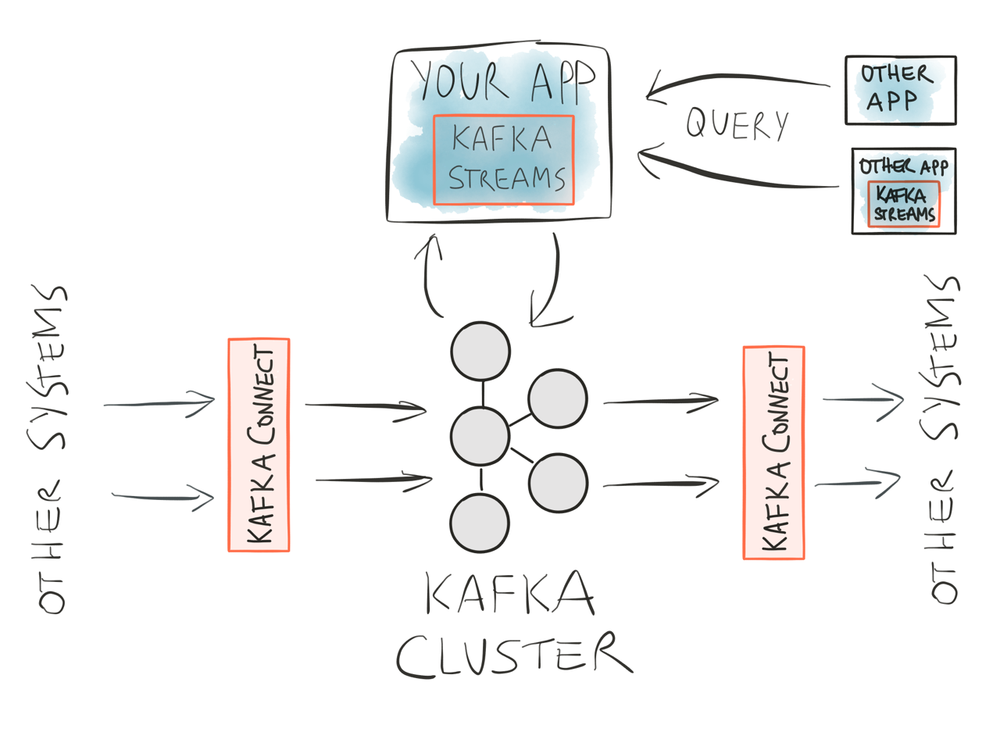
Kafka Streams?

Slide 5
What is Kafka Streams: Unix analogy
Kafka Connect
Kafka Streams
$ cat < in.txt | grep “apache” | tr a-z A-Z > out.txt
Kafka Core

Slide 6
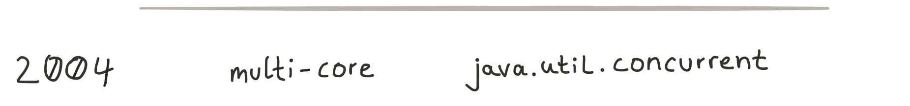

What is Kafka Streams: Java analogy

Slide 7
When to use Kafka Streams
Mainstream Application Development
When running a cluster would suck
Fast Data apps for small and big data
Reactive and stateful applications
Continuous transformations
Continuous queries
Microservices
Event-driven systems
The “T” in ETL
<and more>

Slide 8
Some use cases in the wild & external articles
Applying Kafka Streams for internal message delivery pipeline at LINE Corp.
http://developers.linecorp.com/blog/?p=3960
Kafka Streams in production at LINE, a social platform based in Japan with 220+ million users
Microservices and reactive applications
https://speakerdeck.com/bobbycalderwood/commander-decoupled-immutable-rest-apis-with-kafka-streams
User behavior analysis
https://timothyrenner.github.io/engineering/2016/08/11/kafka-streams-not-looking-at-facebook.html
Containerized Kafka Streams applications in Scala
https://www.madewithtea.com/processing-tweets-with-kafka-streams.html
Geo-spatial data analysis
http://www.infolace.com/blog/2016/07/14/simple-spatial-windowing-with-kafka-streams/
Language classification with machine learning
https://dzone.com/articles/machine-learning-with-kafka-streams

Slide 9

Do more with less

Slide 10
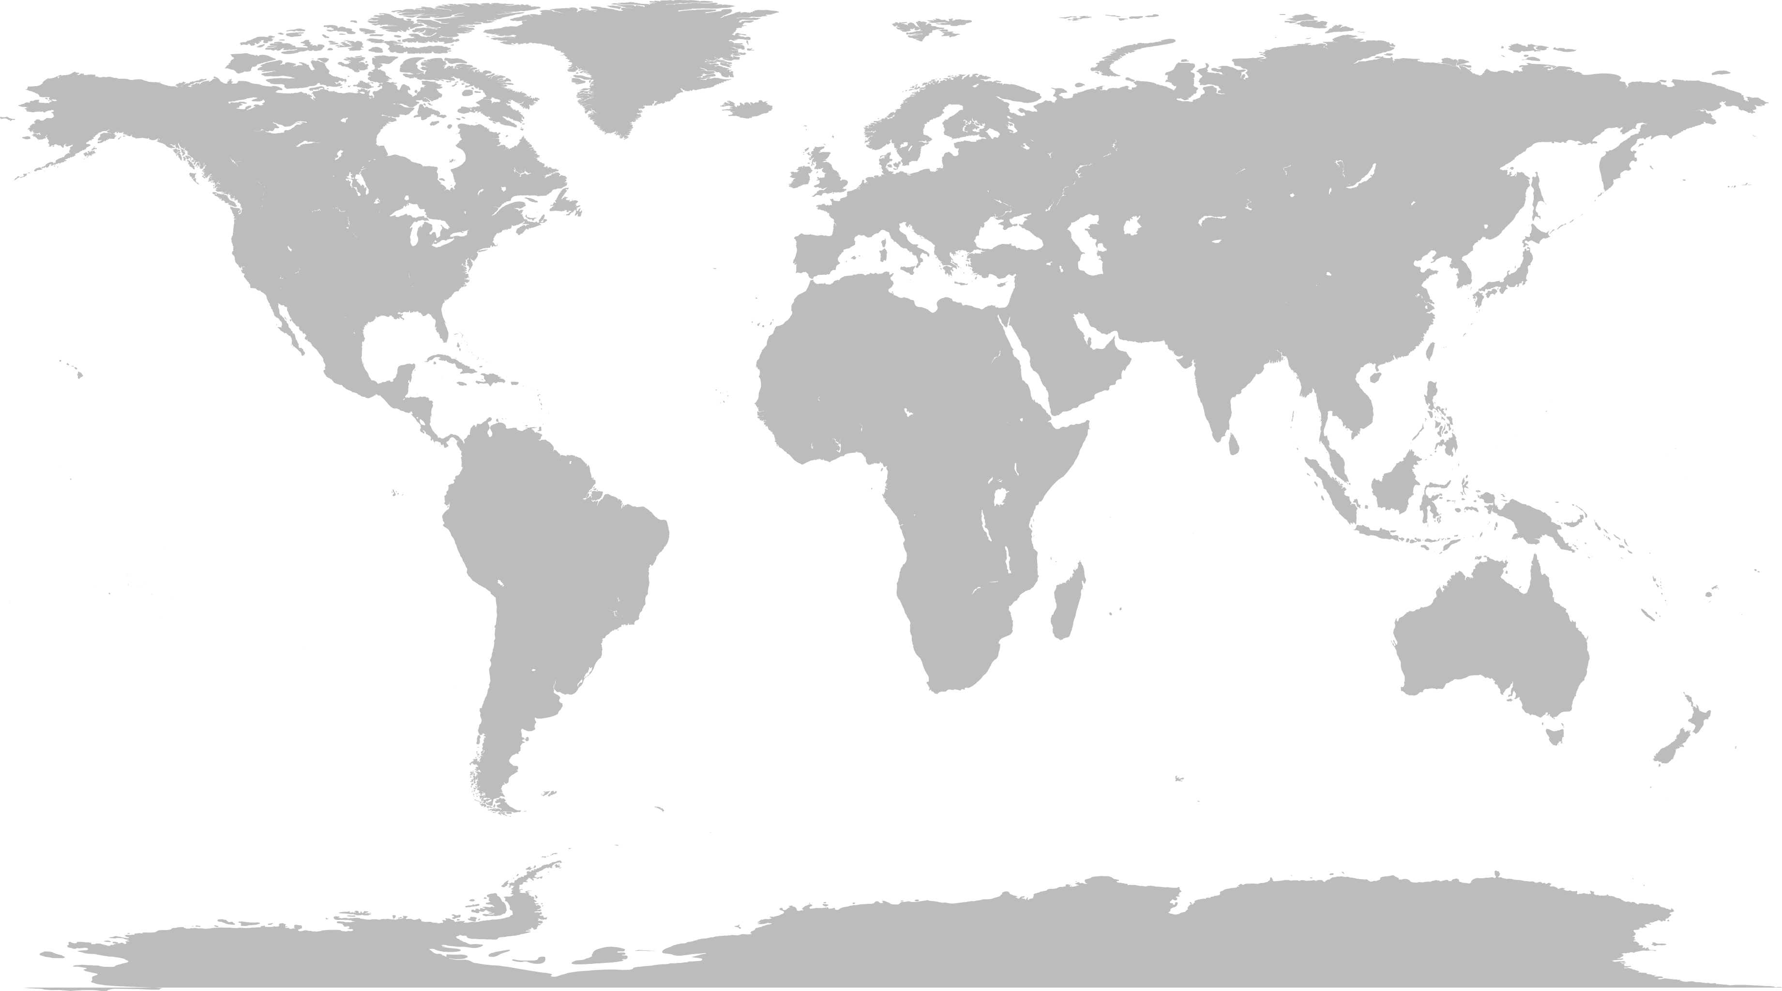
Architecture comparison: use case example
Real-time dashboard for security monitoring
“Which of my data centers are under attack?”

Slide 11

Architecture comparison: use case example
Complexity: a lot of moving pieces that are also complex individually
App
Conflicting priorities: infrastructure teams vs. product teams
App
Is all this a part of the solution or part of your problem?
separate processing cluster
App
Your
“Job”
Kafka Streams: simplified, more app-centric architecture for many use cases
App
Your App
Kafka Streams
App
App

Slide 12
How do I install Kafka Streams?
There is and there should be no “installation” – Build Apps, Not Clusters!
It’s a library. Add it to your app like any other library.
<dependency>
<groupId>org.apache.kafka</groupId>
<artifactId>kafka-streams</artifactId>
<version>0.10.0.1</version>
</dependency>

Slide 13

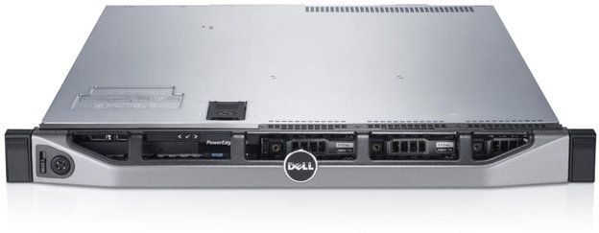
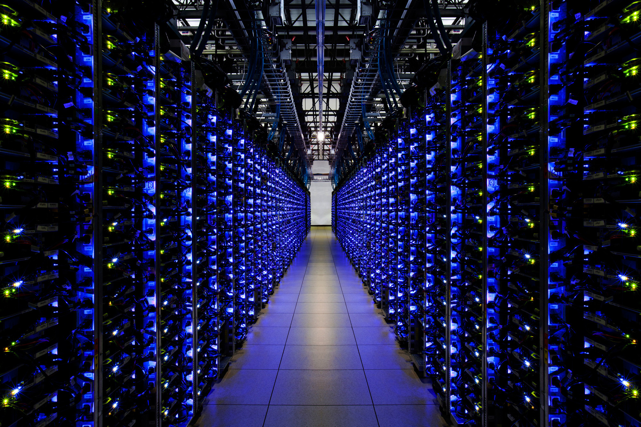
“But wait a minute – where’s THE CLUSTER to process the data?”
No cluster needed – Build Apps, Not Clusters!
Unlearn bad habits: “do cool stuff with data ≠ must have cluster”
Ok.
Ok.
Ok.

Slide 14
Organizational benefits: decouple teams and roadmaps
Mobile team
...
In-App Recommendations app
...more apps...
Payments team
Operations team
Fraud detection
app
Security Alerts
app
Infrastructure Team (Kafka as a shared, multi-tenant service)
Notes:
Cf. Conway’s law: “organizations which design systems ... are constrained to produce designs which are copies of the communication structures of these organizations”
Empower teams in LOB to innovate and be agile
Decouple LOB from infrastructure teams
This is possible thanks to Kafka’s [backwards] compatibility approach (newer clusters work with older clients). We want to make this compatibility story even stronger by adding forward compatibility (newer clients work with older clusters).

Slide 15

Kafka Streams is a team player

Slide 16
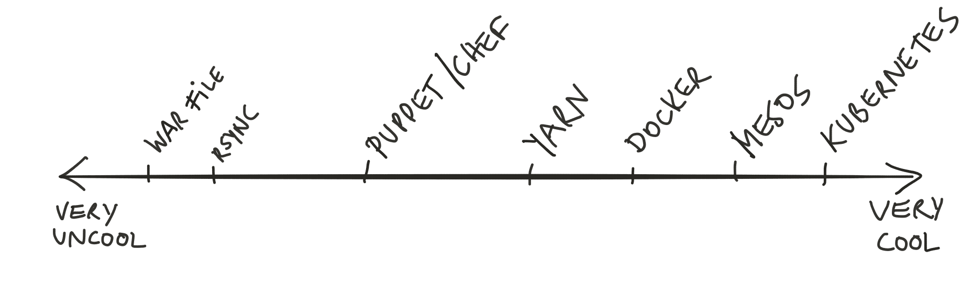
How do I package and deploy my apps? How do I …?
Whatever works for you. Stick to what you/your company think is the best way.
Kafka Streams integrates well with what you already have.
Why? Because an app that uses Kafka Streams is…a normal Java app.
Notes:
FYI: Mesosphere is a Confluent partner. You can run the Confluent Platform on Mesosphere DC/OS.

Slide 17
Tip: how to get your conference talk accepted
“A #distributed, #dockerized #scala application for #kafka to implement #reactive #microservices, running on #mesos.”

Slide 18
Available APIs
Notes:
Alright, let’s still show the APIs before we continue with the more interesting bits and pieces.

Slide 19
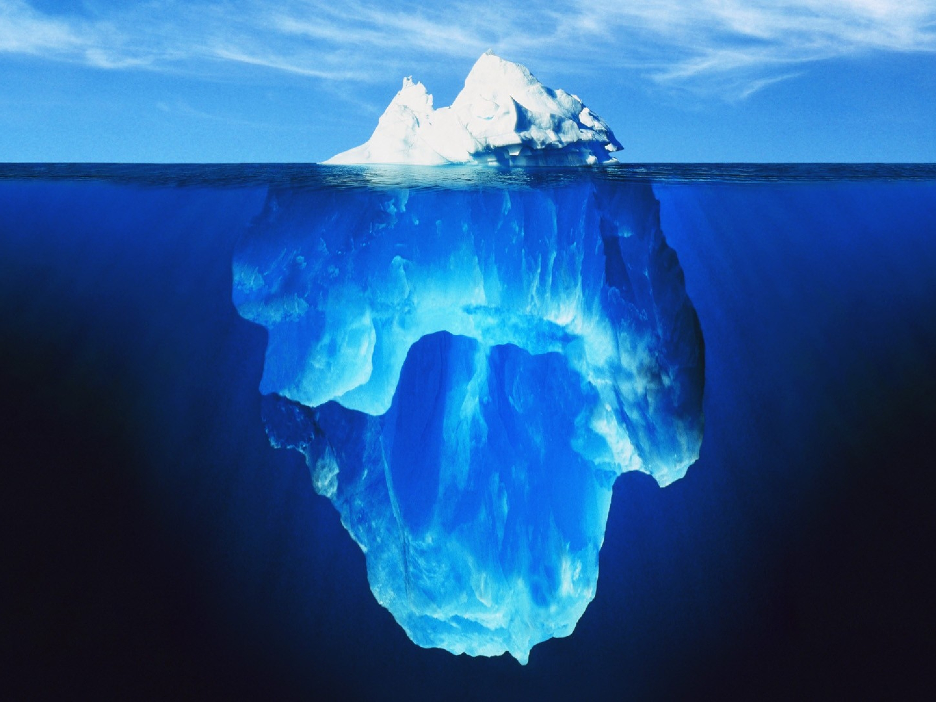
The API is but the tip of the iceberg
API, coding
Architecture
Deployment
Reality™
Operations
Security
Org. processes
Debugging
…
Notes:
The APIs of Kafka Streams are expressive, flexible, and easy to use. But let us highlight that “the API” is just the tip of the iceberg. There is much more to a stream processing technology than the API.
So when evaluating, you should ask questions such as:
If you ARE running at large scale, what is the cost for doing so (notably operations)?
If you ARE NOT running at large scale, what is the tool’s minimum investment? Is the tool cost-effective for small to medium scale, too?
Same questions if you set out to design and build a tool.

Slide 20
API option 1: Kafka Streams DSL (declarative)
KStream<Integer, Integer> input = builder.stream("numbers-topic");
// Stateless computation
KStream<Integer, Integer> doubled = input.mapValues(v -> v * 2);
// Stateful computation
KTable<Integer, Integer> sumOfOdds = input .filter((k,v) -> v % 2 != 0) .selectKey((k, v) -> 1)
.groupByKey()
.reduce((v1, v2) -> v1 + v2, "sum-of-odds");
The preferred API for most use cases.
The DSL particularly appeals to users:
When familiar with Spark, Flink
When fans of Scala or functional programming

Slide 21
API option 2: Processor API (imperative)
class PrintToConsoleProcessor implements Processor<K, V> {
@Override
public void init(ProcessorContext context) {}
@Override
void process(K key, V value) {
System.out.println("Received record with " +
"key=" + key + " and value=" + value);
}
@Override
void punctuate(long timestamp) {}
@Override
void close() {}
}
Full flexibility but more manual work
The Processor API appeals to users:
When familiar with Storm, Samza
Still, check out the DSL!
When requiring functionality that is not yet available in the DSL

Slide 22
When to use Kafka Streams vs. Kafka’s “normal” consumer clients
Kafka Streams
Basically all the time
Basically all the time
Basically all the time
Basically all the time
Basically all the time
Basically all the time
Basically all the time
Basically all the time
Basically all the time
Basically all the time
Basically all the time
Kafka consumer clients (Java, C/C++, Python, Go, …)
When you must interact with Kafka at a very low level and/or in a very special way
Example: When integrating your own stream processing tool (Spark, Storm) with Kafka.

Slide 23
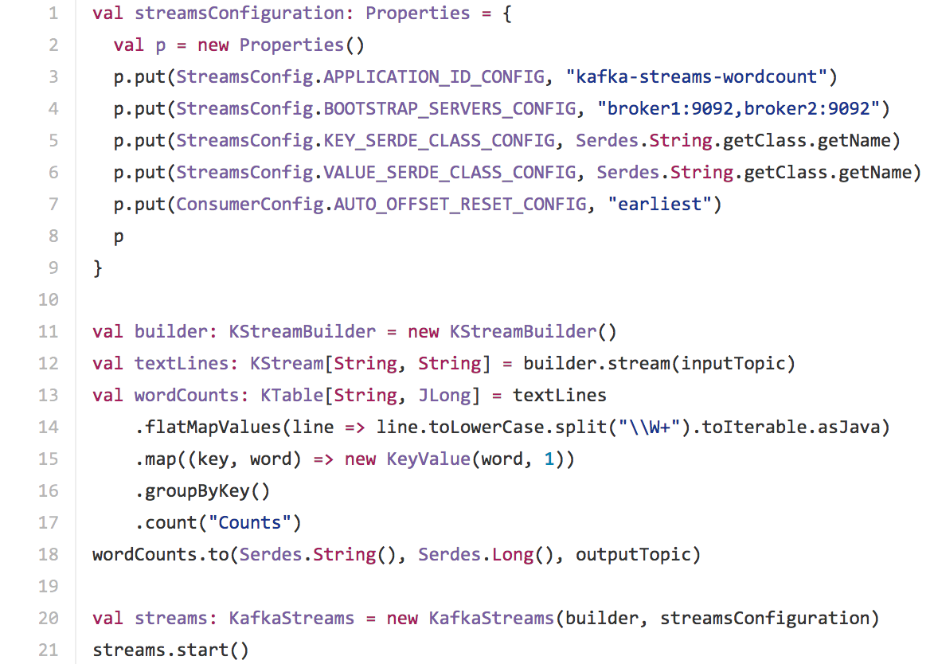
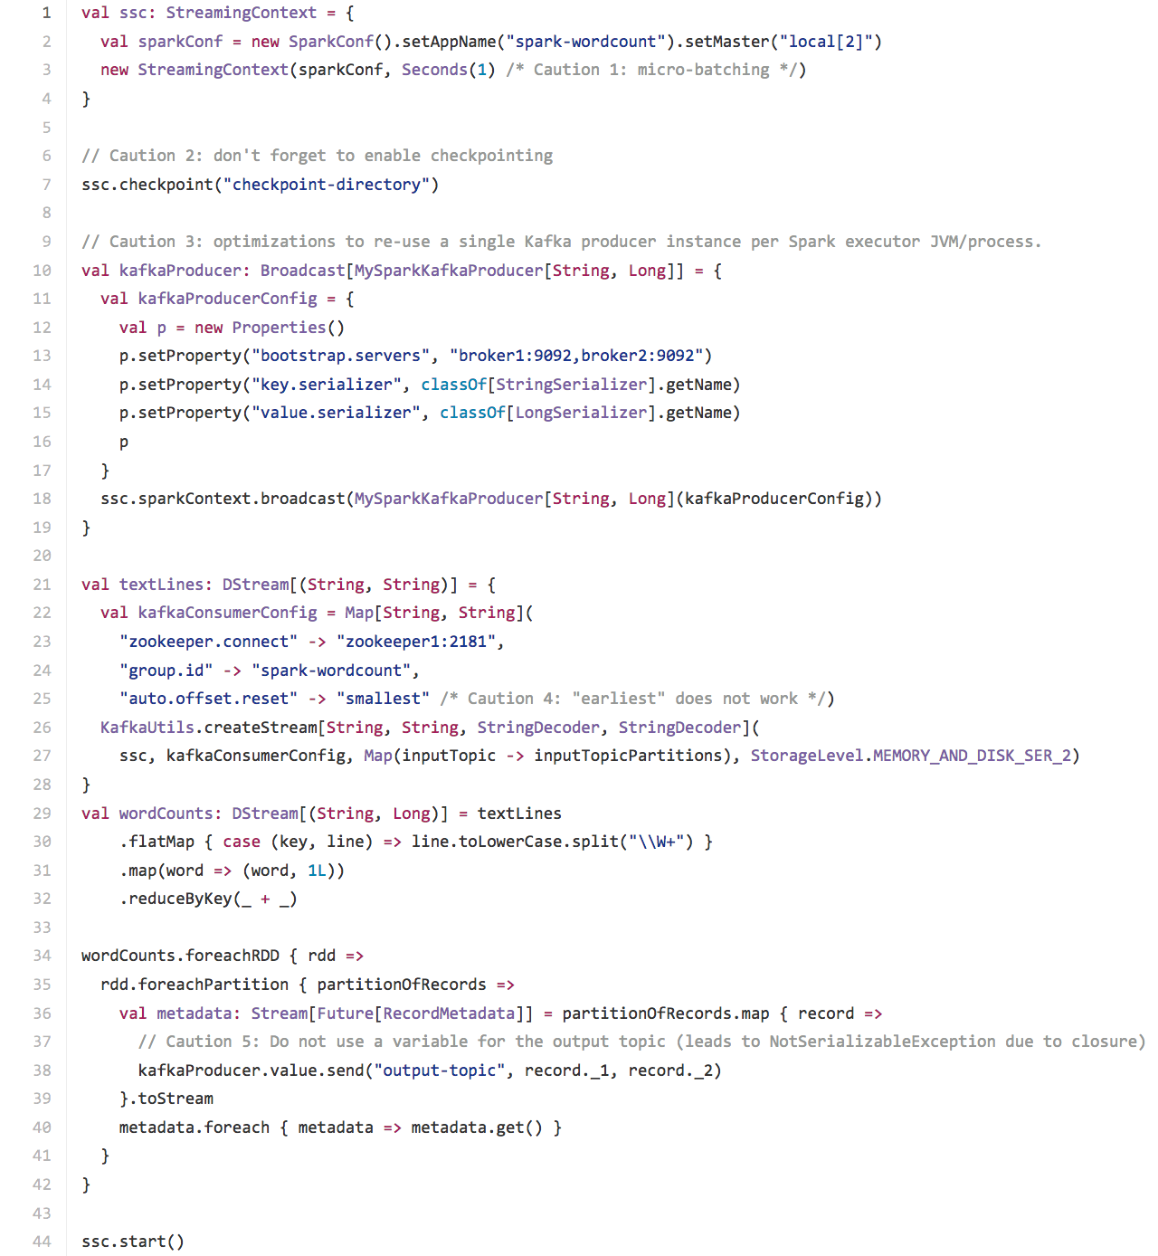
”My WordCount is better than your WordCount!”
Kafka
Spark
These isolated code snippets are nice (and actually quite similar) but they are not very meaningful. In practice, we also need to read data from somewhere, write data back to somewhere, etc.– but we can see none of this here.

Slide 24
The purpose of the following comparison is to show concrete examples
(rather than high-level talk) to point out some general differences between Kafka Streams and other, related stream processing technologies. Here, we happen to compare Kafka Streams with Spark. But we could have also compared with Storm, Samza, Akka Streams, etc.

Slide 25
WordCount in Kafka
Word Count

Slide 26
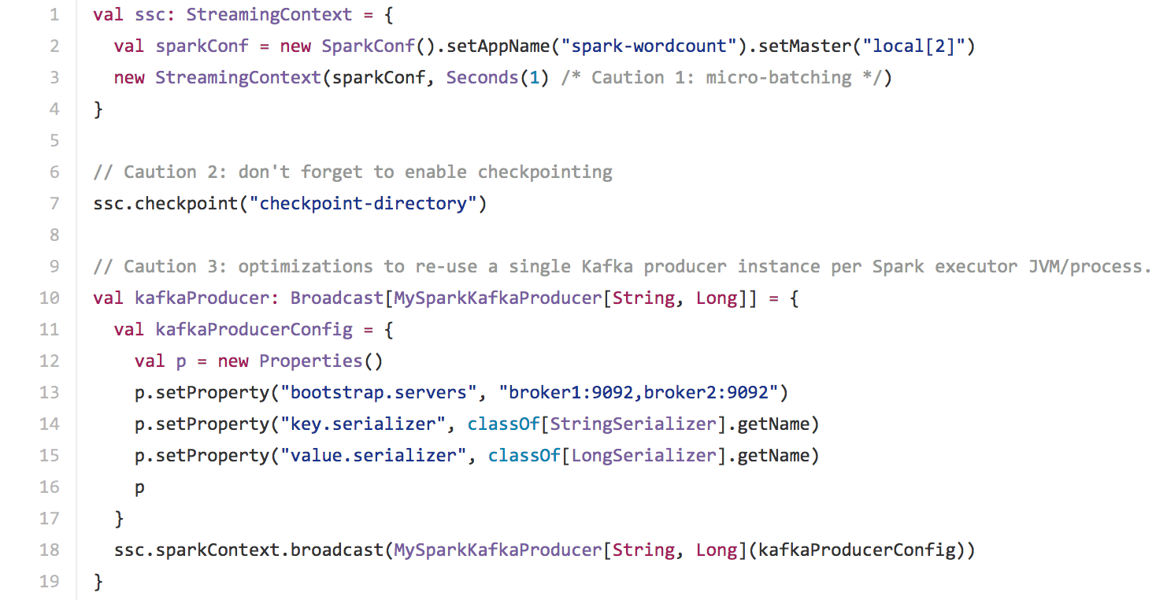
Compared to: WordCount in Spark 2.0
1
2
3
Runtime model leaks into processing logic (here: interfacing from Spark with Kafka)

Slide 27
Compared to: WordCount in Spark 2.0
4
5
Runtime model leaks into processing logic (driver vs. executors)

Slide 28
Kafka Streams key concepts

Slide 29
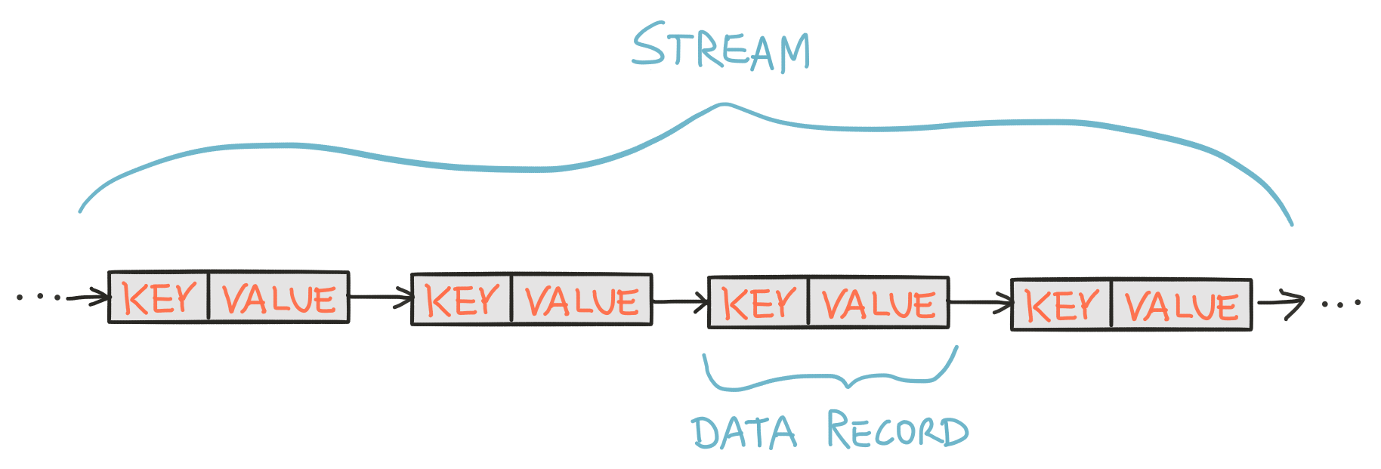
Key concepts
Notes:
Kafka Streams has a very similar data model as Kafka Core. (We won’t need to go into further details here.)

Slide 30
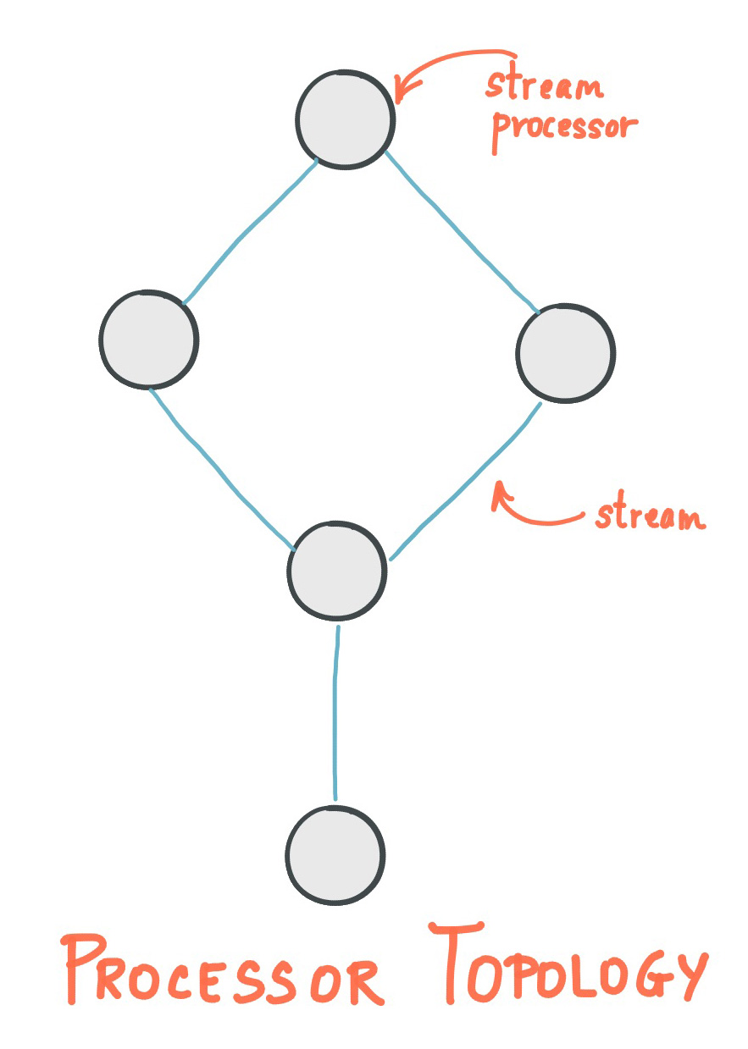
Key concepts
Notes:
The processing logic of your application is defined through a processor topology, which consists of nodes (stream processors = stream processing steps) and edges (streams) that connect the nodes. If you use the DSL, all of this is hidden from you. If you use the Processor API, you can (and must) define the topology manually.

Slide 31
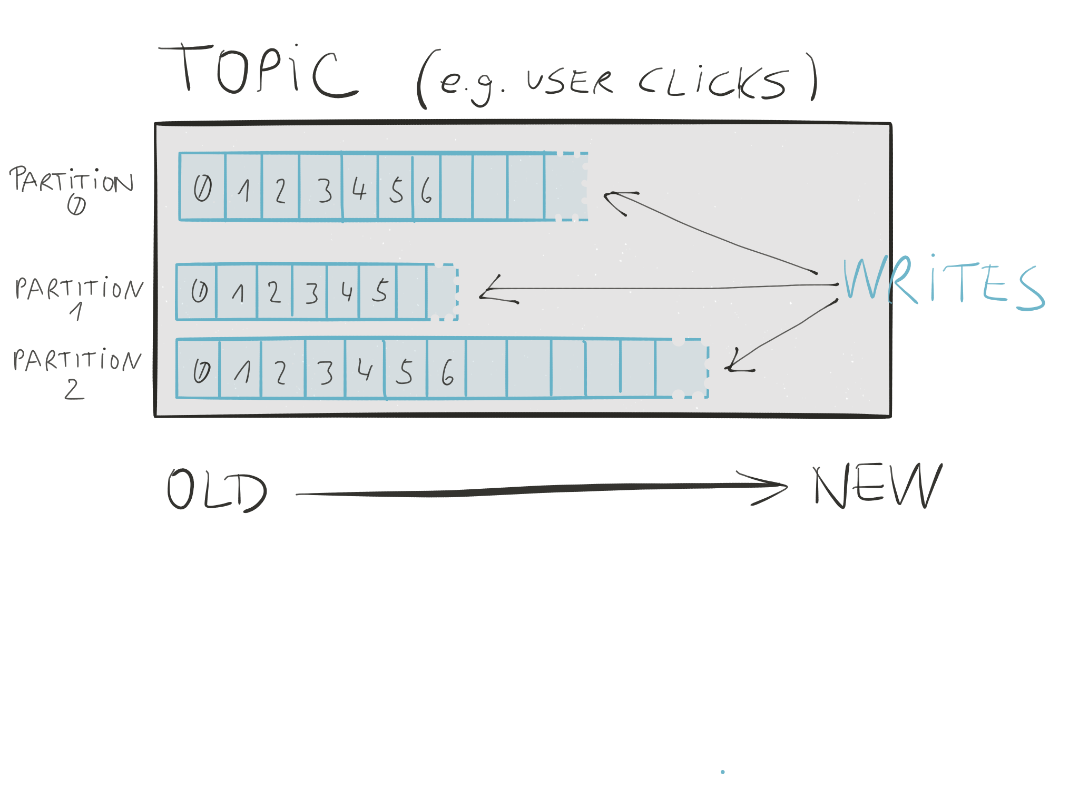
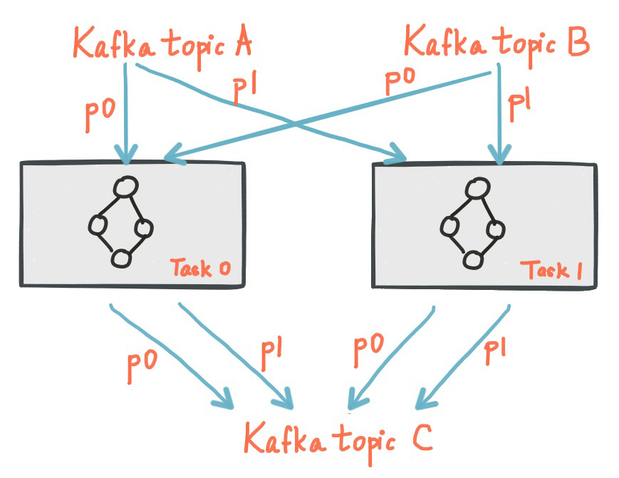
Key concepts
Kafka Core
Kafka Streams
Notes:
Kafka partitions data for storing and transporting it.
Kafka Streams partitions data for processing it.
In both cases, this partitioning enables data locality, elasticity, scalability, high performance, and fault-tolerance.
That’s all we want to mention at this point because we want to rather talk about something more interesting and more important: the stream-table duality.

Slide 32
Streams meet Tables
Theory meets Practice

Slide 33
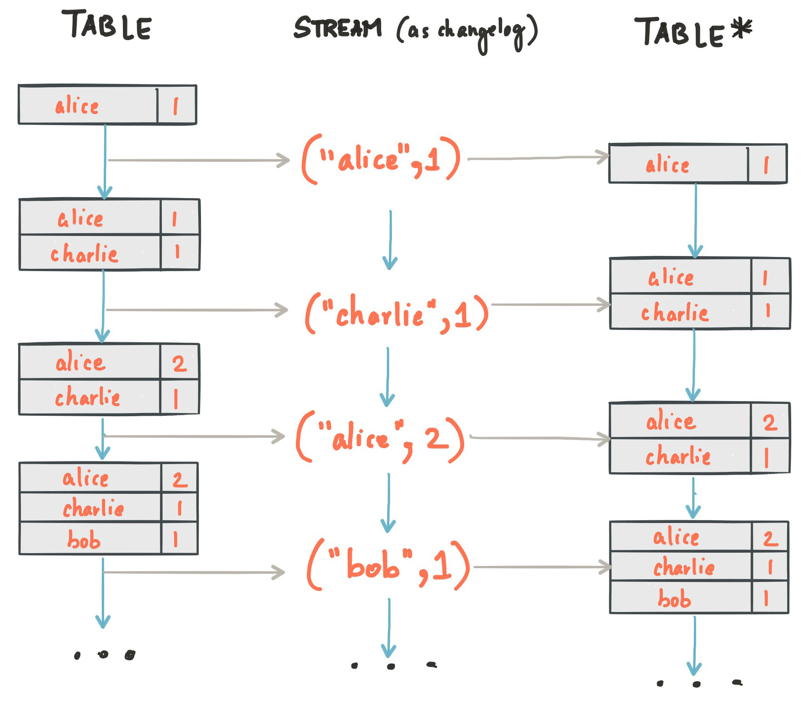
Streams meet Tables
http://www.confluent.io/blog/introducing-kafka-streams-stream-processing-made-simple http://docs.confluent.io/current/streams/concepts.html#duality-of-streams-and-tables

Slide 34
Motivating example: continuously compute current users per geo-region
Real-time dashboard “How many users younger than 30y, per region?”
5
4
8
3
7
2
user-locations (mobile team)
alice
Asia, 25y, …
bob
Europe, 46y, …
user-prefs (web team)
…
…
Notes:
Imagine that one of your products is a real-time dashboard that shows the current number of users in each region of the world. This dashboard is powered by a stream processing application that (1) builds detailed user profiles by joining data from a variety of Kafka topics and (2) computes statistics on these user profiles. The Kafka topics could include, for example, a user-preferences topic based on direct user input (e.g. birthday/age) plus a user-location topic that receives automatic geo-location updates from a user’s mobile device (”In Paris right now!”). Also, it is pretty likely that, in practice, the various information sources (topics) are managed by different teams: the user-locations topic could be managed by the mobile app team, and the user-prefs topic by the frontend team.
Now what you want to happen is that every time there is a new piece of information arriving in the upstream Kafka topics (say, a geo-location update for user Alice), then this information should automatically and quickly propagate throughout the data pipeline to update the dashboard. As we will see, implementing such a stream processing application with Kafka Streams is easy and straight-forward.

Slide 35
Motivating example: continuously compute current users per geo-region
Real-time dashboard “How many users younger than 30y, per region?”
5
4
8
user-locations
3
alice
Europe
7
2
user-locations (mobile team)
alice
Asia, 25y, …
bob
Europe, 46y, …
user-prefs (web team)
…
…
Notes:
Imagine that one of your products is a real-time dashboard that shows the current number of users in each region of the world. This dashboard is powered by a stream processing application that (1) builds detailed user profiles by joining data from a variety of Kafka topics and (2) computes statistics on these user profiles. The Kafka topics could include, for example, a user-preferences topic based on direct user input (e.g. birthday/age) plus a user-location topic that receives automatic geo-location updates from a user’s mobile device (”In Paris right now!”).
Now what you want to happen is that every time there is a new piece of information arriving in the upstream Kafka topics (say, a geo-location update for user Alice), then this information should automatically and quickly propagate throughout the data pipeline to update the dashboard. As we will see, implementing such a stream processing application with Kafka Streams is easy and straight-forward.

Slide 36
Motivating example: continuously compute current users per geo-region
Real-time dashboard “How many users younger than 30y, per region?”
5
4
8
user-locations
3
alice
Europe
7
2
user-locations (mobile team)
alice
Asia, 25y, …
alice
Europe, 25y, …
bob
Europe, 46y, …
bob
Europe, 46y, …
user-prefs (web team)
…
…
…
…
Notes:
Imagine that one of your products is a real-time dashboard that shows the current number of users in each region of the world. This dashboard is powered by a stream processing application that (1) builds detailed user profiles by joining data from a variety of Kafka topics and (2) computes statistics on these user profiles. The Kafka topics could include, for example, a user-preferences topic based on direct user input (e.g. birthday/age) plus a user-location topic that receives automatic geo-location updates from a user’s mobile device (”In Paris right now!”).
Now what you want to happen is that every time there is a new piece of information arriving in the upstream Kafka topics (say, a geo-location update for user Alice), then this information should automatically and quickly propagate throughout the data pipeline to update the dashboard. As we will see, implementing such a stream processing application with Kafka Streams is easy and straight-forward.

Slide 37
Motivating example: continuously compute current users per geo-region
Real-time dashboard “How many users younger than 30y, per region?”
Alice
+1
5
6
-1
4
8
user-locations
4
7
3
alice
Europe
3
7
7
2
2
user-locations (mobile team)
alice
Asia, 25y, …
alice
Europe, 25y, …
bob
Europe, 46y, …
bob
Europe, 46y, …
user-prefs (web team)
…
…
…
…
Notes:
Imagine that one of your products is a real-time dashboard that shows the current number of users in each region of the world. This dashboard is powered by a stream processing application that (1) builds detailed user profiles by joining data from a variety of Kafka topics and (2) computes statistics on these user profiles. The Kafka topics could include, for example, a user-preferences topic based on direct user input (e.g. birthday/age) plus a user-location topic that receives automatic geo-location updates from a user’s mobile device (”In Paris right now!”).
Now what you want to happen is that every time there is a new piece of information arriving in the upstream Kafka topics (say, a geo-location update for user Alice), then this information should automatically and quickly propagate throughout the data pipeline to update the dashboard. As we will see, implementing such a stream processing application with Kafka Streams is easy and straight-forward.

Slide 38
Same data, but different use cases require different interpretations
alice
San Francisco
alice
New York City
alice
Rio de Janeiro
alice
Sydney
alice
Beijing
alice
Paris
alice
Berlin
Notes:
Ok, we saw the motivating example. Let’s take a step back and work back again towards this motivating example.

Slide 39
Same data, but different use cases require different interpretations
alice
San Francisco
alice
New York City
alice
Rio de Janeiro
Use case 1: Frequent traveler status?
alice
Sydney
Use case 2: Current location?
alice
Beijing
alice
Paris
alice
Berlin

Slide 40
Same data, but different use cases require different interpretations
Use case 1: Frequent traveler status?
Use case 2: Current location?
“Alice has been to SFO, NYC, Rio, Sydney, Beijing, Paris, and finally Berlin.”
“Alice is in SFO, NYC, Rio, Sydney, Beijing, Paris, Berlin right now.”
⚑
⚑
⚑
⚑
⚑
⚑
⚑
⚑
⚑
⚑
⚑
⚑
⚑
⚑

Slide 41
Same data, but different use cases require different interpretations
⚑
alice
San Francisco
⚑
⚑
⚑
⚑
⚑
⚑
alice
New York City
alice
Rio de Janeiro
Use case 1: Frequent traveler status?
alice
Sydney
Use case 2: Current location?
alice
Beijing
⚑
alice
Paris
alice
Berlin

Slide 42
Same data, but different use cases require different interpretations
⚑
alice
San Francisco
⚑
⚑
⚑
⚑
⚑
⚑
alice
New York City
alice
Rio de Janeiro
Use case 1: Frequent traveler status?
alice
Sydney
Use case 2: Current location?
alice
Beijing
⚑
alice
Paris
alice
Berlin

Slide 43
Same data, but different use cases require different interpretations
⚑
alice
San Francisco
⚑
⚑
⚑
⚑
⚑
⚑
alice
New York City
alice
Rio de Janeiro
Use case 1: Frequent traveler status?
alice
Sydney
Use case 2: Current location?
alice
Beijing
⚑
alice
Paris
alice
Berlin

Slide 44
Streams meet Tables
Example
When you need…
then you’d read the Kafka topic into a
so that the topic is interpreted as a
with messages interpreted as
All the places Alice has ever been to
All the values of a key
KStream
record stream
INSERT (append)
Notes:
Alright, this might seem a bit repetitive but the stream-table duality is an important concept, so looking at the same concept from different angles helps to fully understand it.

Slide 45
Streams meet Tables
Example
When you need…
then you’d read the Kafka topic into a
so that the topic is interpreted as a
with messages interpreted as
All the places Alice has ever been to
All the values of a key
KStream
record stream
INSERT (append)
Where Alice is right now
Latest value of a key
KTable
changelog stream
UPSERT (overwrite existing)
Notes:
KStream = immutable log
KTable ~ mutable materialized view

Slide 46
Same data, but different use cases require different interpretations
Use case 1: Frequent traveler status?
Use case 2: Current location?
“Alice has been to SFO, NYC, Rio, Sydney, Beijing, Paris, and finally Berlin.”
“Alice is in SFO, NYC, Rio, Sydney, Beijing, Paris, Berlin right now.”
⚑
⚑
⚑
⚑
⚑
⚑
⚑
⚑
⚑
⚑
⚑
⚑
⚑
⚑
KStream
KTable

Slide 47
Motivating example: continuously compute current users per geo-region
Real-time dashboard “How many users younger than 30y, per region?”
Alice
+1
5
6
-1
4
8
user-locations
4
7
3
alice
Europe
3
7
7
2
2
user-locations (mobile team)
alice
Asia, 25y, …
alice
Europe, 25y, …
bob
Europe, 46y, …
bob
Europe, 46y, …
user-prefs (web team)
…
…
…
…
Notes:
Going back to the motivating example from the beginning.

Slide 48
Motivating example: continuously compute current users per geo-region
KTable<UserId, Location> userLocations = builder.table(“user-locations-topic”);
KTable<UserId, Prefs> userPrefs = builder.table(“user-preferences-topic”);
Notes:
The point here is NOT this code or how it works in detail. The actual point is: Note how we exclusively use KTables here! That is, not even a single KStream is used or needed (and a KStream equivalent is the only type of abstraction provided by other stream processing technologies). This use case makes it pretty obvious why the concept of a KTable is so powerful, and why the lack of such a concept is a significant drawback for stream processing in practice.
And why do we use only KTables here? Because we are only interested in 1. the latest user location, 2. the latest user preferences, and so on.

Slide 49
Motivating example: continuously compute current users per geo-region
KTable<UserId, Location> userLocations = builder.table(“user-locations-topic”);
KTable<UserId, Prefs> userPrefs = builder.table(“user-preferences-topic”);
// Merge into detailed user profiles (continuously updated)
KTable<UserId, UserProfile> userProfiles =
userLocations.join(userPrefs, (loc, prefs) -> new UserProfile(loc, prefs));
user-locations
alice
Asia, 25y, …
alice
Europe, 25y, …
bob
Europe, 46y, …
alice
Europe
bob
Europe, 46y, …
…
…
…
…
KTable userProfiles
KTable userProfiles
Notes:
The point here is NOT this code or how it works in detail. The actual point is: Note how we exclusively use KTables here! That is, not even a single KStream is used or needed (and a KStream equivalent is the only type of abstraction provided by other stream processing technologies). This use case makes it pretty obvious why the concept of a KTable is so powerful, and why the lack of such a concept is a significant drawback for stream processing in practice.
And why do we use only KTables here? Because we are only interested in 1. the latest user location, 2. the latest user preferences, and so on.

Slide 50
Motivating example: continuously compute current users per geo-region
KTable<UserId, Location> userLocations = builder.table(“user-locations-topic”);
KTable<UserId, Prefs> userPrefs = builder.table(“user-preferences-topic”);
// Merge into detailed user profiles (continuously updated)
KTable<UserId, UserProfile> userProfiles =
userLocations.join(userPrefs, (loc, prefs) -> new UserProfile(loc, prefs));
// Compute per-region statistics (continuously updated)
KTable<UserId, Long> usersPerRegion = userProfiles .filter((userId, profile) -> profile.age < 30)
.groupBy((userId, profile) -> profile.location)
.count();
Africa
3
Africa
3
user-locations
…
…
…
…
Asia
8
alice
Europe
Asia
7
Europe
5
Europe
6
KTable usersPerRegion
KTable usersPerRegion
Notes:
The point here is NOT this code or how it works in detail. The actual point is: Note how we exclusively use KTables here! That is, not even a single KStream is used or needed (and a KStream equivalent is the only type of abstraction provided by other stream processing technologies). This use case makes it pretty obvious why the concept of a KTable is so powerful, and why the lack of such a concept is a significant drawback for stream processing in practice.
And why do we use only KTables here? Because we are only interested in 1. the latest user location, 2. the latest user preferences, and so on.

Slide 51
Motivating example: continuously compute current users per geo-region
Real-time dashboard “How many users younger than 30y, per region?”
KTable
Alice
+1
5
6
-1
4
8
user-locations
4
7
3
alice
Europe
3
7
7
2
2
KTable
KTable
KTable
user-locations (mobile team)
alice
Asia, 25y, …
alice
Europe, 25y, …
bob
Europe, 46y, …
bob
Europe, 46y, …
user-prefs (web team)
…
…
…
…
KTable
Notes:
KTables everywhere! Plus: Interactive Queries!

Slide 52
Another common use case: continuous transformations
Example: to enrich an input stream (user clicks) with side data (current user profile)
user-clicks-topics (at 1M msgs/s)
KStream
alice
/rental/p8454vb, 06:59 PM PDT
“facts”
Notes:
In the previous, motivating example we highlighted the use of KTable. Let’s also showcase KStream.

Slide 53
Another common use case: continuous transformations
Example: to enrich an input stream (user clicks) with side data (current user profile)
user-clicks-topics (at 1M msgs/s)
KStream
alice
/rental/p8454vb, 06:59 PM PDT
“facts”
alice
Asia, 25y
KTable
bob
Europe, 46y
“dimensions”
…
…
user-profiles-topic

Slide 54
Another common use case: continuous transformations
Example: to enrich an input stream (user clicks) with side data (current user profile)
user-clicks-topics (at 1M msgs/s)
KStream
alice
/rental/p8454vb, 06:59 PM PDT
“facts”
stream.JOIN(table)
alice
/rental/p8454vb, 06:59 PDT, Asia, 25y
alice
Asia, 25y
KTable
bob
Europe, 46y
“dimensions”
…
…
user-profiles-topic

Slide 55
Another common use case: continuous transformations
Example: to enrich an input stream (user clicks) with side data (current user profile)
user-clicks-topics (at 1M msgs/s)
KStream
alice
/rental/p8454vb, 06:59 PM PDT
“facts”
stream.JOIN(table)
alice
/rental/p8454vb, 06:59 PDT, Asia, 25y
alice
Asia, 25y
alice
Europe, 25y
KTable
bob
Europe, 46y
bob
Europe, 46y
“dimensions”
…
…
alice
Europe
…
…
user-profiles-topic
new update for alice from user-locations topic

Slide 56
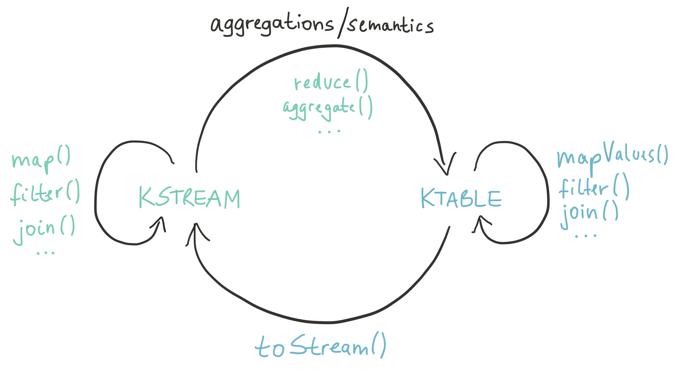
Streams meet Tables – in the Kafka Streams DSL

Slide 57
Kafka Streams key features

Slide 58
Key features in 0.10
Native, 100%-compatible Kafka integration

Slide 59
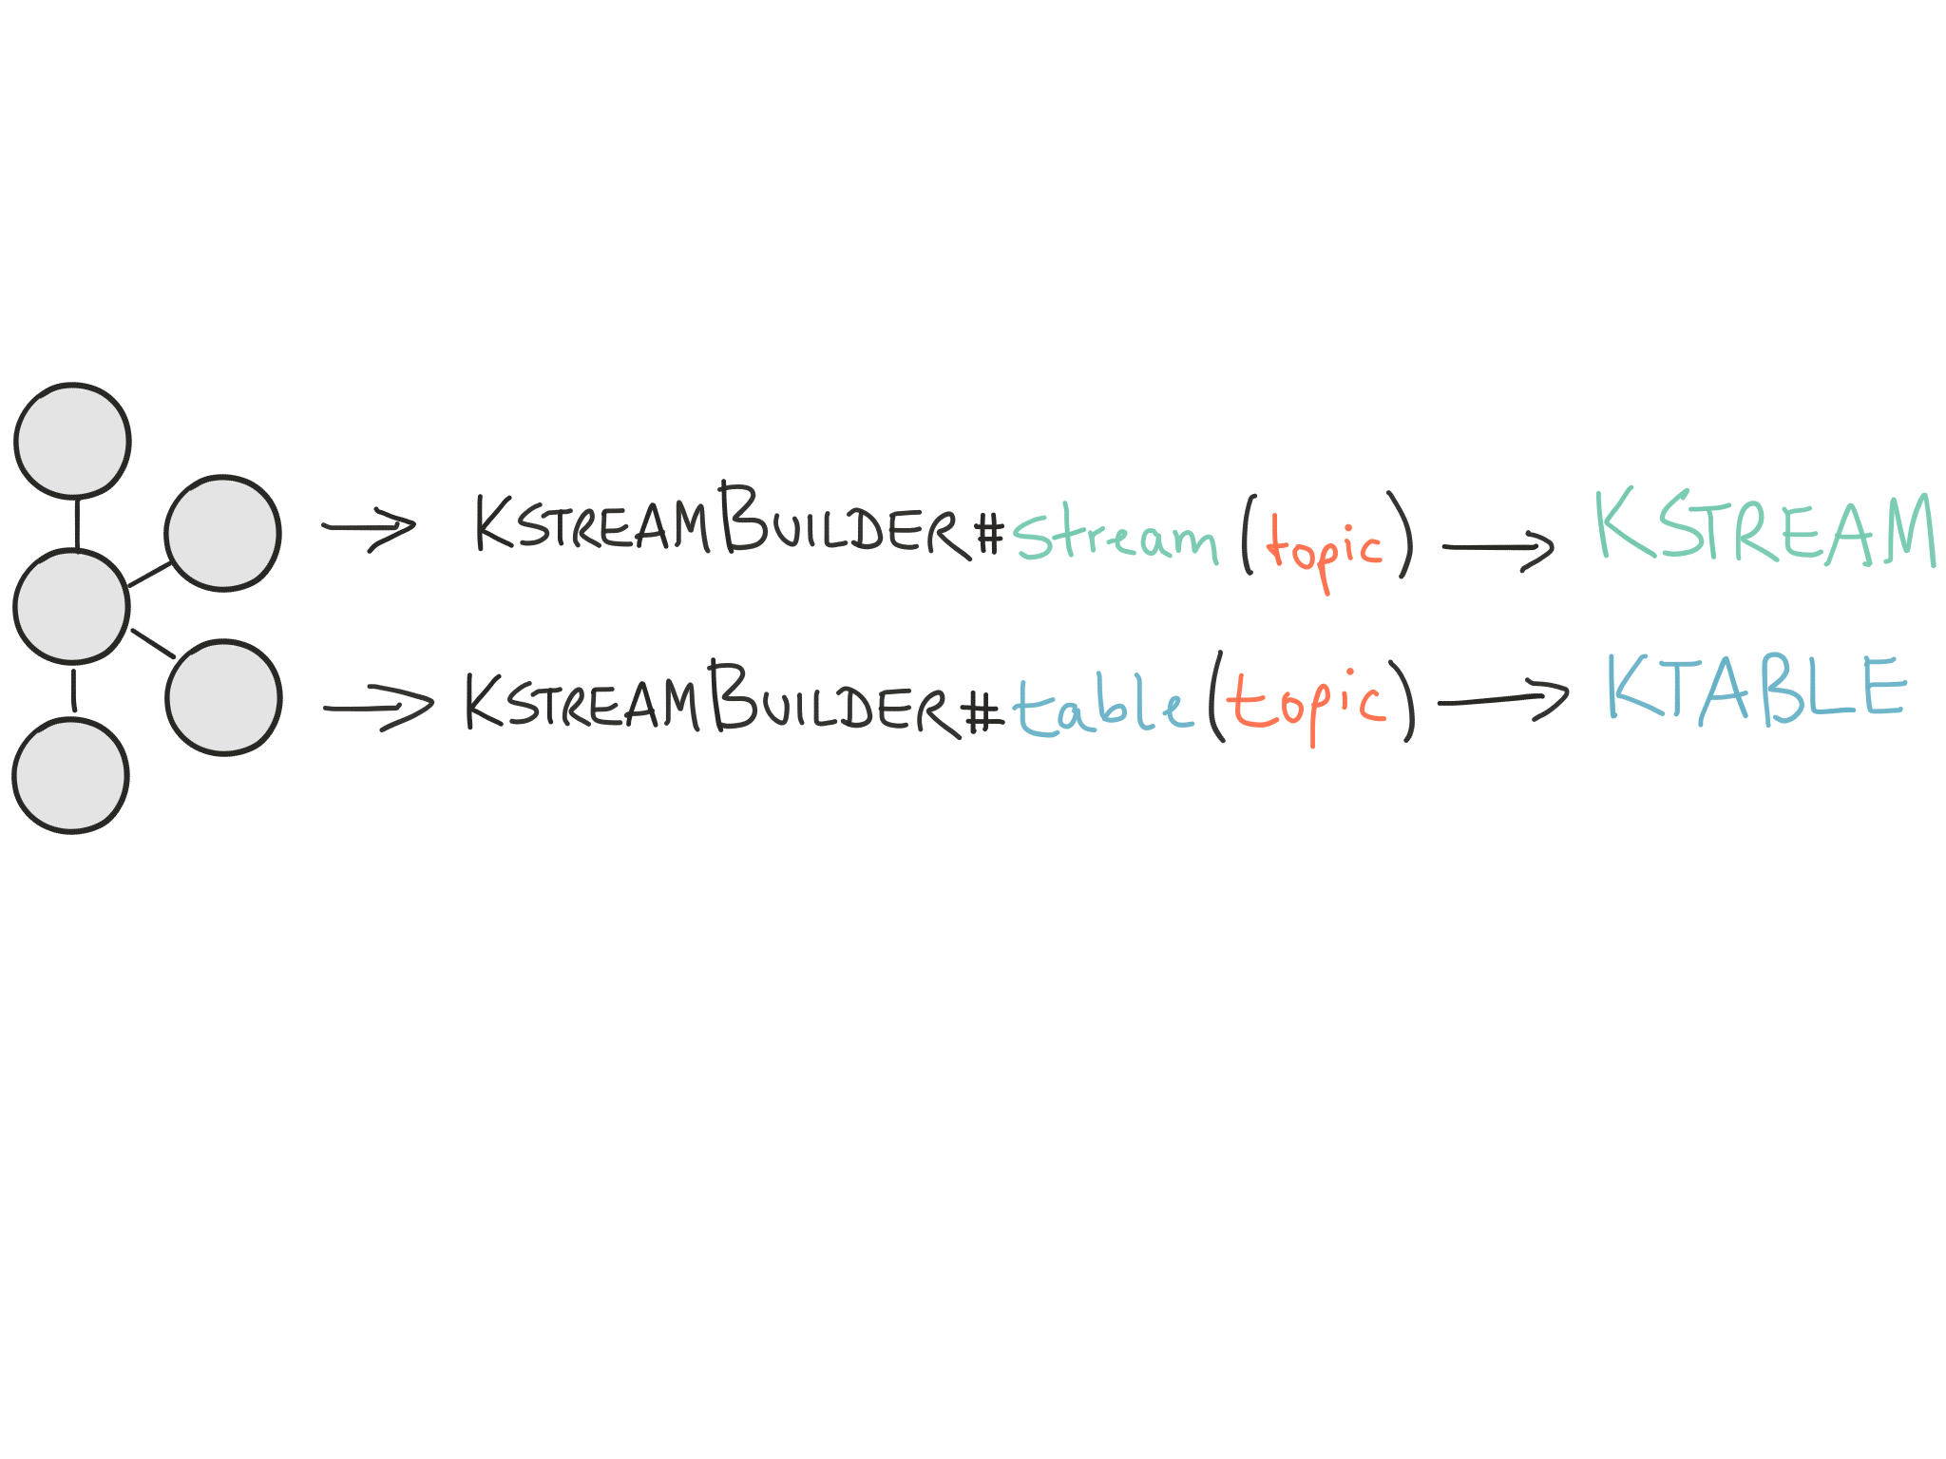
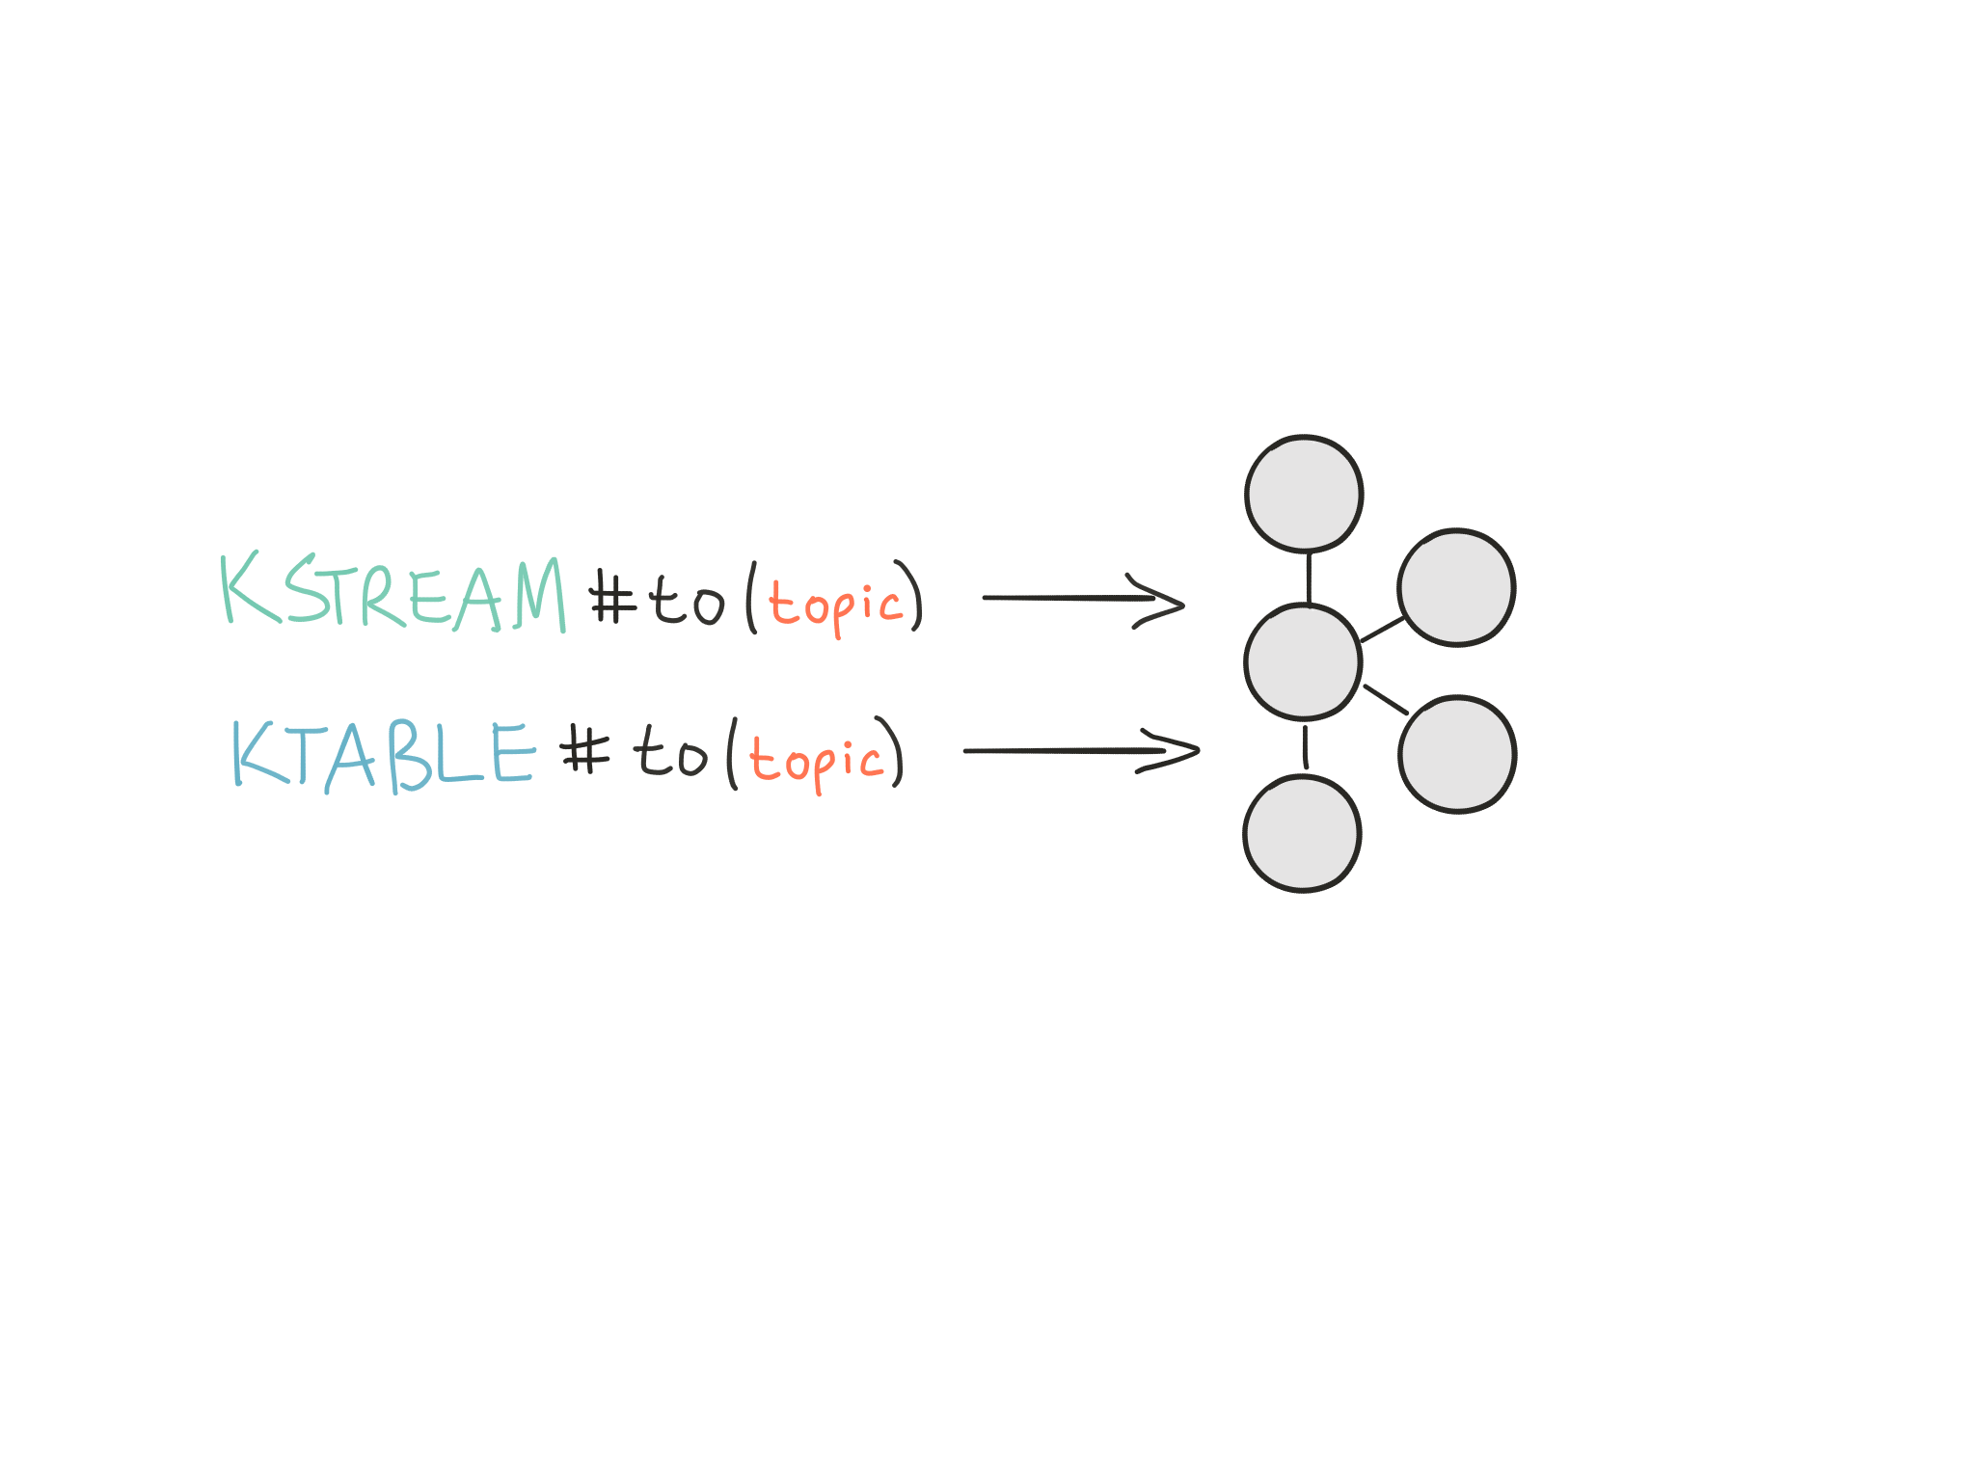
Native, 100% compatible Kafka integration
Read from Kafka
Write to Kafka

Slide 60
Key features in 0.10
Native, 100%-compatible Kafka integration
Secure stream processing using Kafka’s security features

Slide 61
Secure stream processing with Kafka Streams
Kafka Streams applications can leverage all client-side security features in Apache Kafka
Security features include:
Encrypting data-in-transit between applications and Kafka clusters
Authenticating applications against Kafka clusters (“only some apps may talk to the production cluster”)
Authorizing application against Kafka clusters (“only some apps may read data from sensitive topics”)

Slide 62
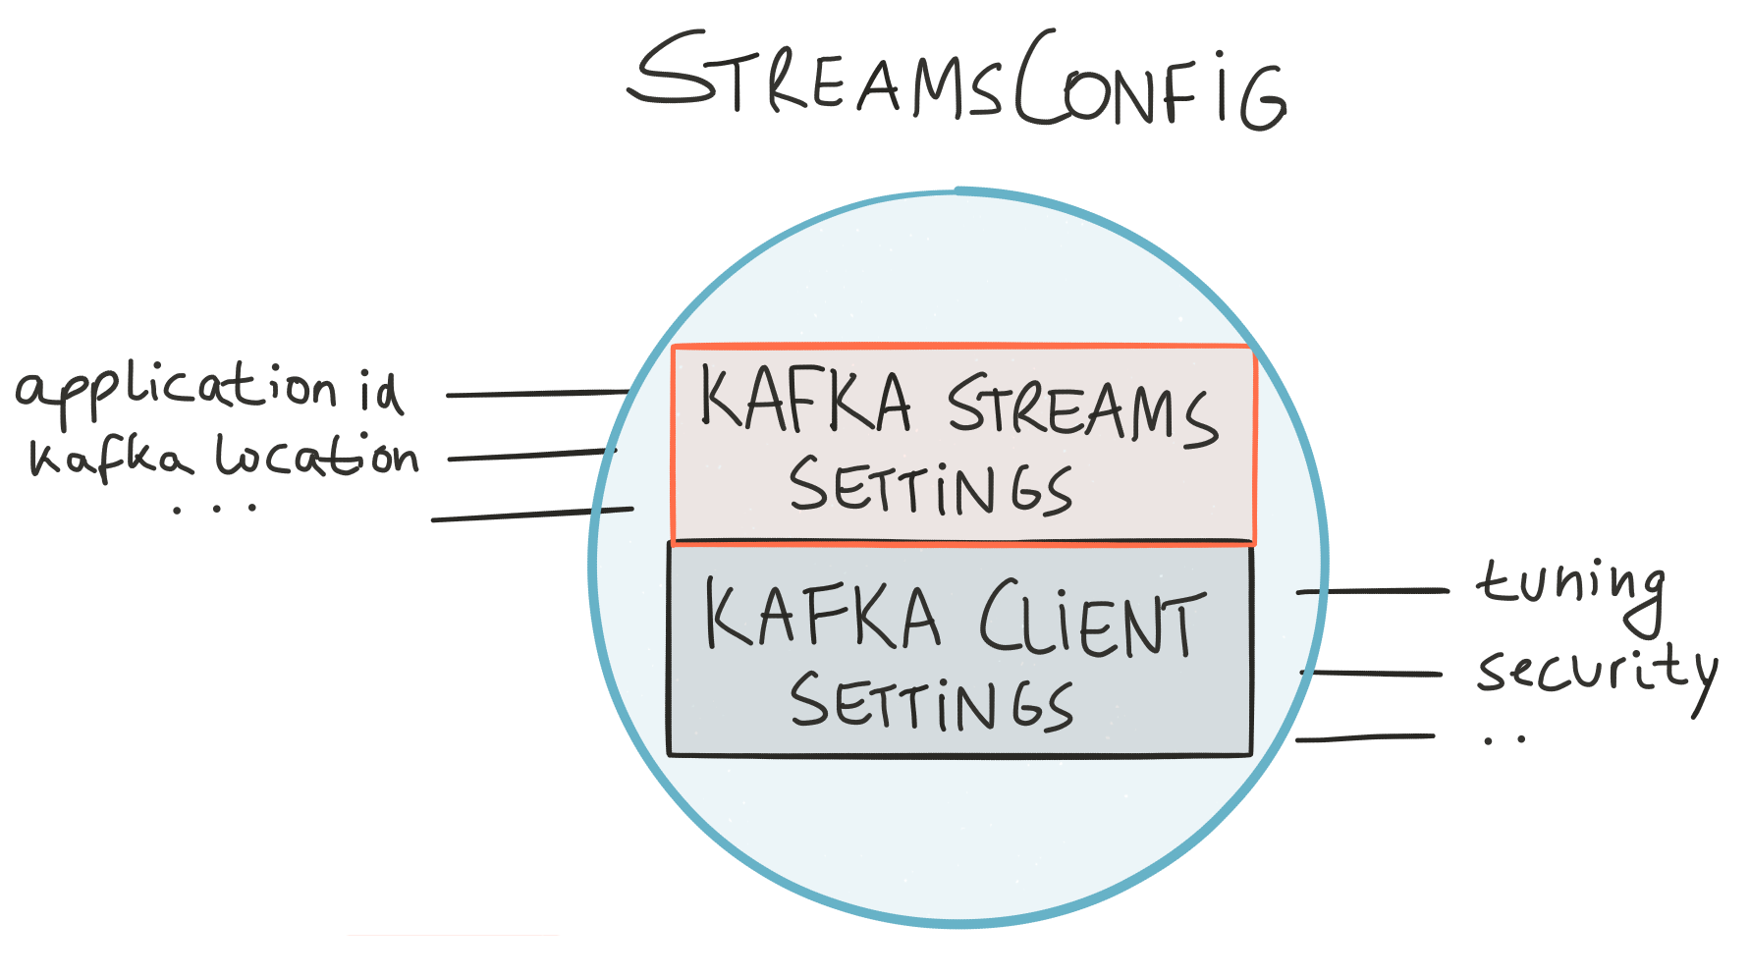
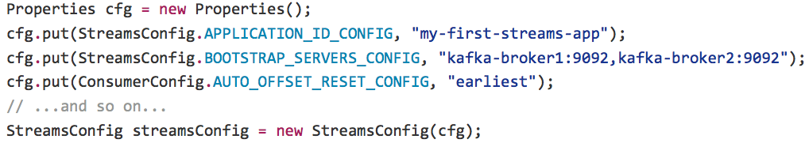
Configuring security settings
In general, you can configure both Kafka Streams plus the underlying Kafka clients in your apps

Slide 63
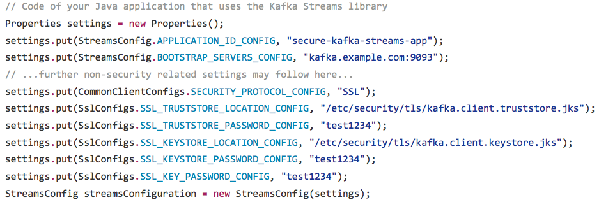
Configuring security settings
Example: encrypting data-in-transit + client authentication to Kafka cluster
Full demo application at https://github.com/confluentinc/examples

Slide 64
Key features in 0.10
Native, 100%-compatible Kafka integration
Secure stream processing using Kafka’s security features
Elastic and highly scalable
Fault-tolerant

Slide 65
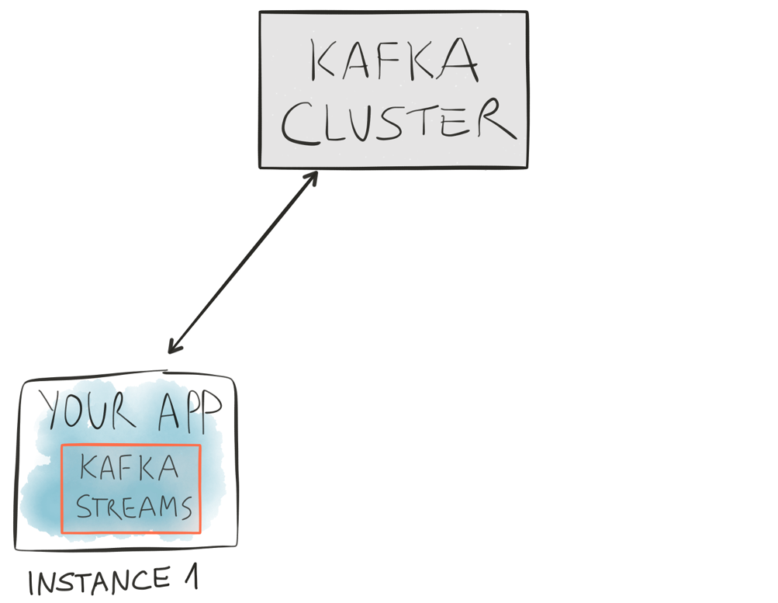
Scalability, fault tolerance, elasticity

Slide 66
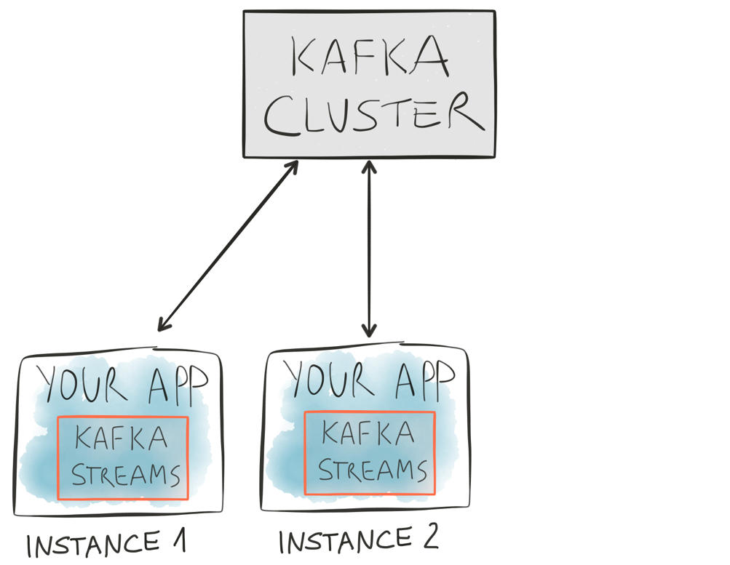
Scalability, fault tolerance, elasticity

Slide 67
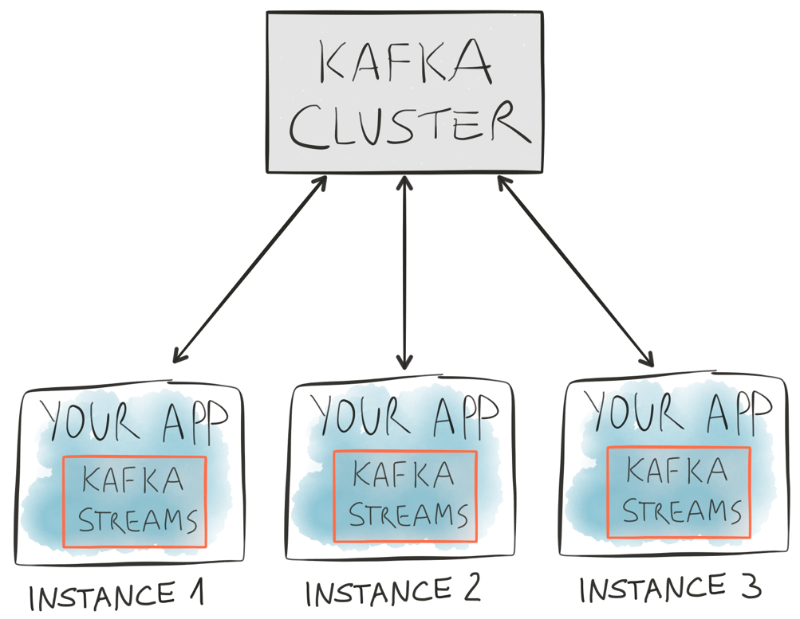
Scalability, fault tolerance, elasticity

Slide 68
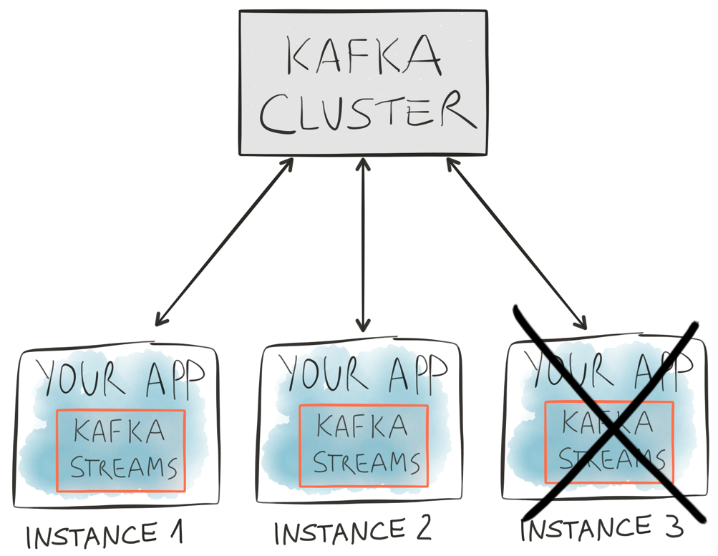
Scalability, fault tolerance, elasticity

Slide 69
Key features in 0.10
Native, 100%-compatible Kafka integration
Secure stream processing using Kafka’s security features
Elastic and highly scalable
Fault-tolerant
Stateful and stateless computations

Slide 70
Stateful computations
Stateful computations like aggregations or joins require state
We already showed a join example in the previous slides.
Windowing a stream is stateful, too, but let’s ignore this for now.
Example: count() will cause the creation of a state store to keep track of counts
State stores in Kafka Streams
… are per stream task for isolation (think: share-nothing)
… are local for best performance
… are replicated to Kafka for elasticity and for fault-tolerance
Pluggable storage engines
Default: RocksDB (key-value store) to allow for local state that is larger than available RAM
Further built-in options available: in-memory store
You can also use your own, custom storage engine

Slide 71
State management with built-in fault-tolerance
(This is a bit simplified.)
State stores

Slide 72
State management with built-in fault-tolerance
(This is a bit simplified.)
alice
1
bob
1
charlie
3
alice
2
State stores
Notes:
Remember the stream-table duality we talked about earlier? A state store is also a kind of table, so we can and do log any changes to the various state stores into Kafka (“changelog streams”).

Slide 73
State management with built-in fault-tolerance
(This is a bit simplified.)
State stores
Notes:
Now if one of the application instances is taken down (e.g. maintenance, reducing the capacity of the app to save operating costs) / fails (e.g. machine crash) …

Slide 74
State management with built-in fault-tolerance
(This is a bit simplified.)
alice
2
State stores
alice
1
Notes:
… then we can reconstruct the app instance’s local state on the remaining live instances of the application by replaying the state store’s changelog stream. What really happens here is that Kafka Streams will migrate any stream task(s) from the terminated instance to the remaining live instances, and each stream task has its own state store(s), assigned partitions, and so on.
Note that, in practice, more than just one app instances will typically take over the work – i.e. stream tasks – from the terminated instance. The diagram above is, as highlighted, a simplification.

Slide 75
Remember? Streams meet Tables
http://www.confluent.io/blog/introducing-kafka-streams-stream-processing-made-simple http://docs.confluent.io/current/streams/concepts.html#duality-of-streams-and-tables

Slide 76
How to use state stores for stateful computations
DSL
“Just works”
DSL abstracts state stores away from you
Stateful operations include count(), reduce(), aggregate(), …
Processor API
You have direct access to state stores
Very flexible but more manual work for you

Slide 77
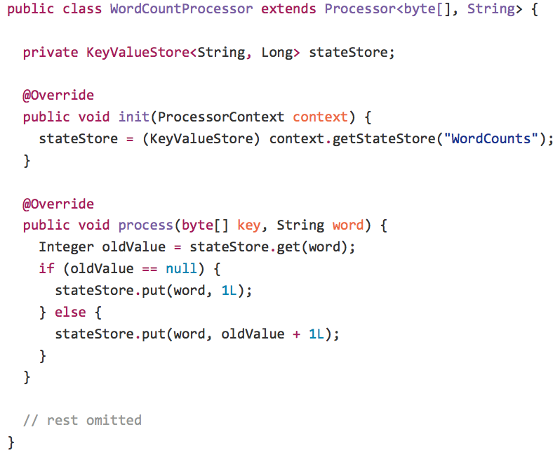
Stateful computations
Use the Processor API to interact directly with state stores
Get the store
Use the store

Slide 78
Key features in 0.10
Native, 100%-compatible Kafka integration
Secure stream processing using Kafka’s security features
Elastic and highly scalable
Fault-tolerant
Stateful and stateless computations
Interactive queries

Slide 79
Interactive Queries
Before (0.10.0)
1
Capture business events in Kafka
2
Process the events with Kafka Streams
!
Must use external systems to share latest results
4
Other apps query external systems for latest results
App
App
Kafka Streams
App
App
After (0.10.1): simplified, more app-centric architecture
1
Capture business events in Kafka
2
Process the events with Kafka Streams
3
Now other apps can directly query the latest results
App
App
Kafka Streams
App
App

Slide 80
Interactive Queries

Slide 81
Interactive Queries
bob
5
charlie
3
alice
2

Slide 82
Interactive Queries
New API to access local state stores of an app instance
bob
5
charlie
3
alice
2

Slide 83
Interactive Queries
“host1:4460”
“host5:5307”
“host3:4777”
New API to discover running app instances
bob
5
charlie
3
alice
2

Slide 84
Interactive Queries
You: inter-app communication (RPC layer)
Notes:
Demo app that showcases interactive queries in combination with a REST API

Slide 85
Key features in 0.10
Native, 100%-compatible Kafka integration
Secure stream processing using Kafka’s security features
Elastic and highly scalable
Fault-tolerant
Stateful and stateless computations
Interactive queries
Time model

Slide 86
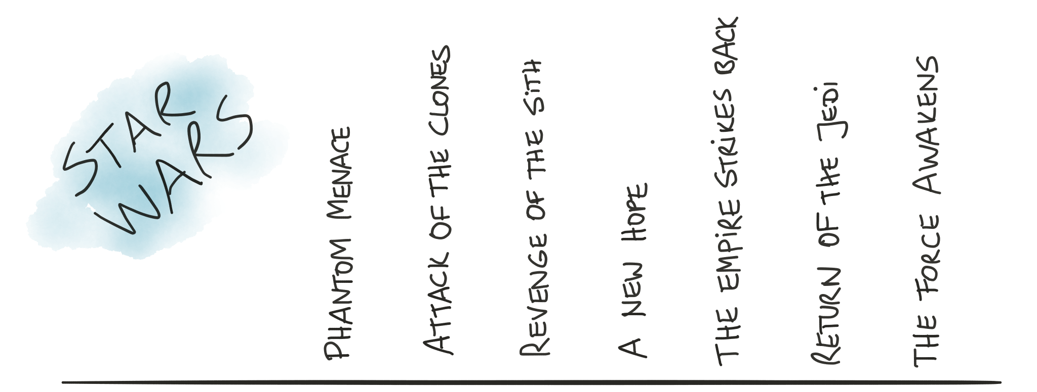
Time

Slide 87
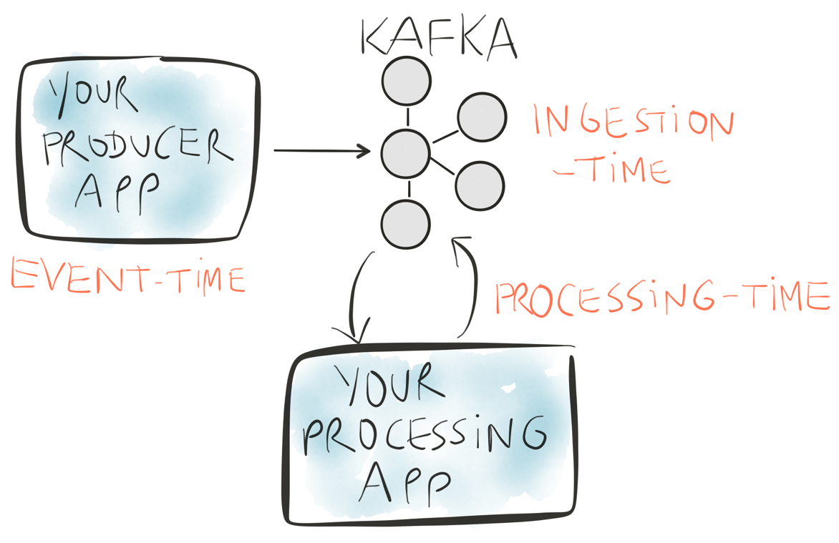

Time

Slide 88
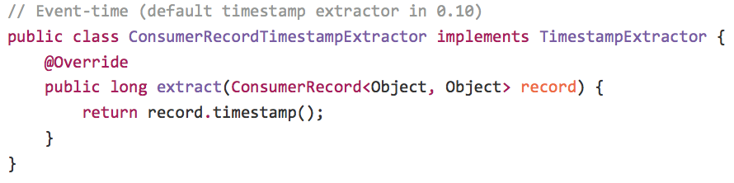
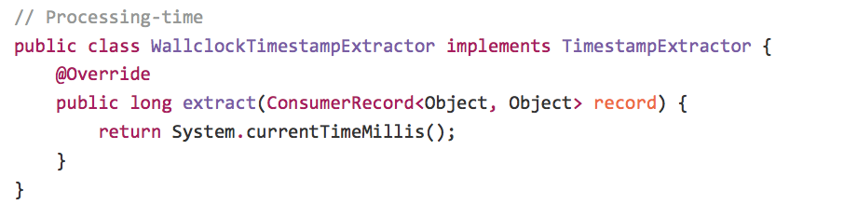
Time
You configure the desired time semantics through timestamp extractors
Default extractor yields event-time semantics
Extracts embedded timestamps of Kafka messages (introduced in v0.10)
Notes:
As you can see, it is very easy to implement a timestamp extractor in case you need to write a custom one. Custom timestamp extractors are primarily used when you are processing input topics where timestamps are included in the message payloads, e.g. in a JSON-formatted message value
Note: The so-called “embedded timestamps” of Kafka (introduced in v0.10) are not considered to be a part of the user-provided message payload.

Slide 89
Key features in 0.10
Native, 100%-compatible Kafka integration
Secure stream processing using Kafka’s security features
Elastic and highly scalable
Fault-tolerant
Stateful and stateless computations
Interactive queries
Time model
Windowing

Slide 90
Windowing
Group events in a stream using time-based windows
Use case examples:
Time-based analysis of ad impressions (”number of ads clicked in the past hour”)
Monitoring statistics of telemetry data (“1min/5min/15min averages”)
Input data, where
colors represent different users events
processing-time
windowing
alice
Rectangles denote different event-time windows
bob
dave
event-time

Slide 91
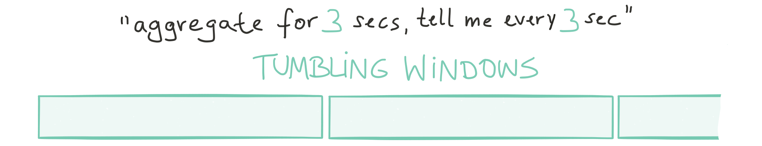
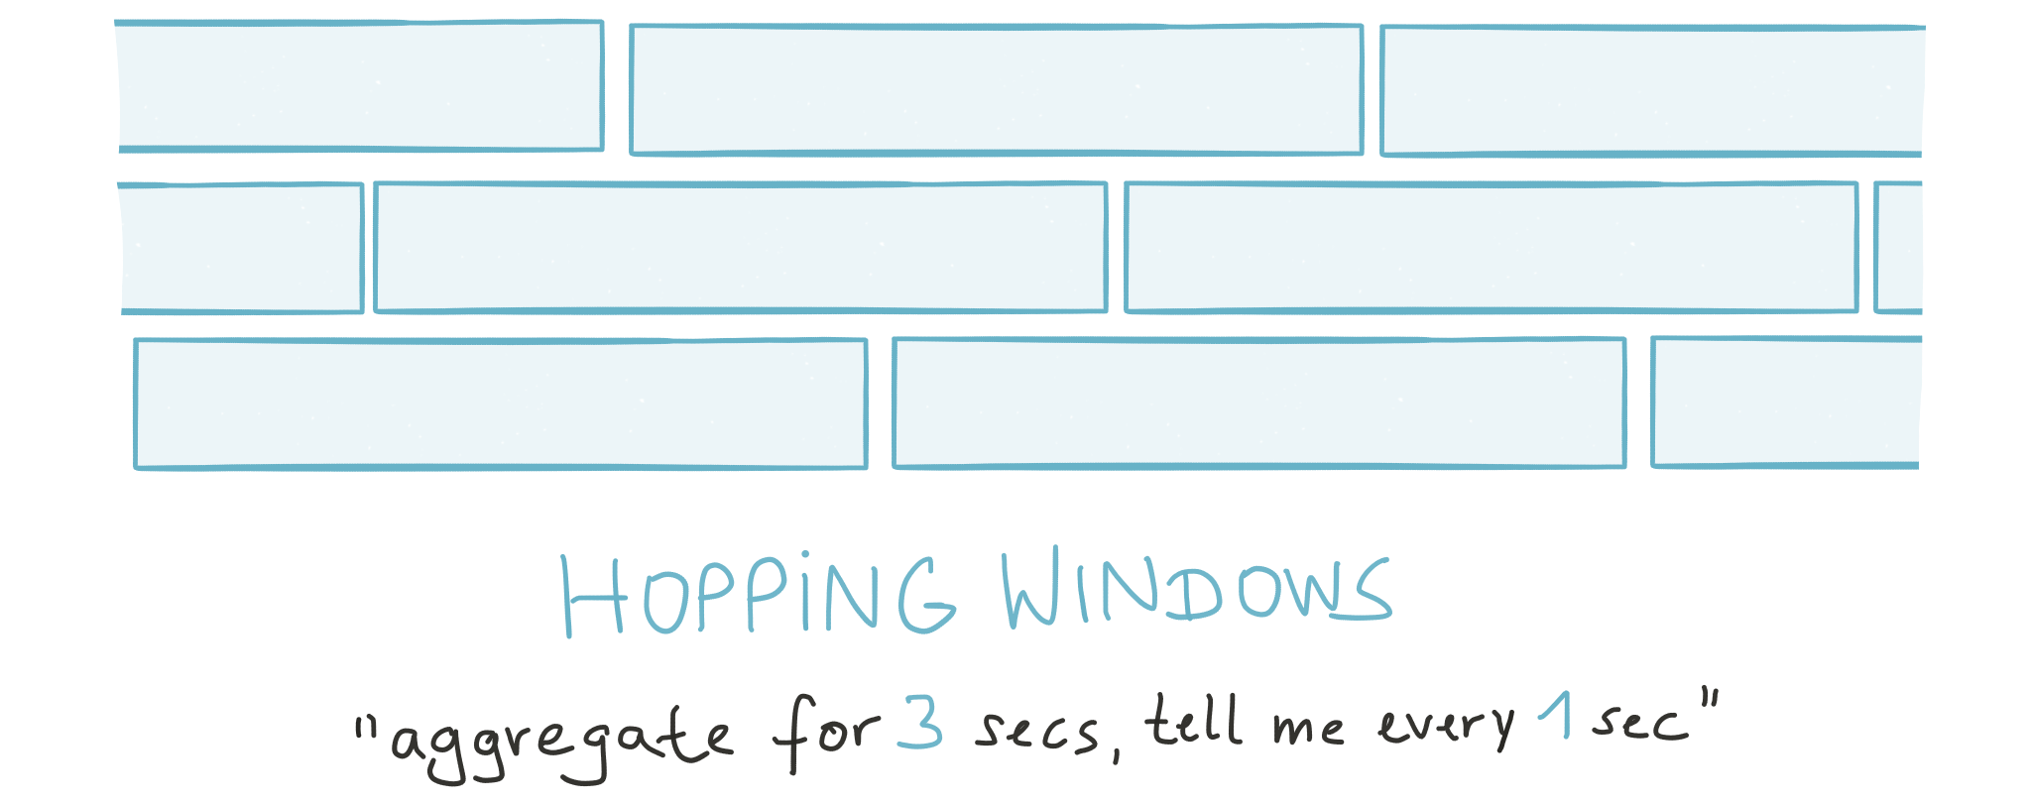
Windowing in the DSL
TimeWindows.of(3000)
TimeWindows.of(3000).advanceBy(1000)

Slide 92
Key features in 0.10
Native, 100%-compatible Kafka integration
Secure stream processing using Kafka’s security features
Elastic and highly scalable
Fault-tolerant
Stateful and stateless computations
Interactive queries
Time model
Windowing
Supports late-arriving and out-of-order data
Millisecond processing latency, no micro-batching
At-least-once processing guarantees (exactly-once is in the works as we speak)

Slide 93
Roadmap Outlook

Slide 94
Roadmap outlook for Kafka Streams
Exactly-once processing semantics
SQL interface
Global state and global KTables
Session windows
…and much more

Slide 95
Wrapping Up

Slide 96
Where to go from here
Join our bi-weekly Confluent Developer Roundtable to discuss all things Apache Kafka
Drop me an email to michael@confluent.io to receive an invite
Kafka Streams is available in Confluent Platform 3.0 and in Apache Kafka 0.10
http://www.confluent.io/download
Kafka Streams demos: https://github.com/confluentinc/examples
Java 7, Java 8+ with lambdas, and Scala
WordCount, Joins, Security, Windowing, Avro integration, …
Recorded talks
Introduction to Kafka Streams: http://www.youtube.com/watch?v=o7zSLNiTZbA
Application Development and Data in the Emerging World of Stream Processing (higher level talk): https://www.youtube.com/watch?v=JQnNHO5506w
Confluent documentation: http://docs.confluent.io/current/streams/
Quickstart, Concepts, Architecture, Developer Guide, FAQ
Apache Kafka documentation: http://kafka.apache.org/documentation.html

Slide 97
Thank You

